Slide 1





REMS
Real Estate Management System (REMS)
A Web-Based Platform for Streamlined Property Management
PROJECT PRESENTER
  Balayet Hosain (212010074)
  Jahanur Islam (212010081)
  Rajesh Barua (212010080)

Slide 2



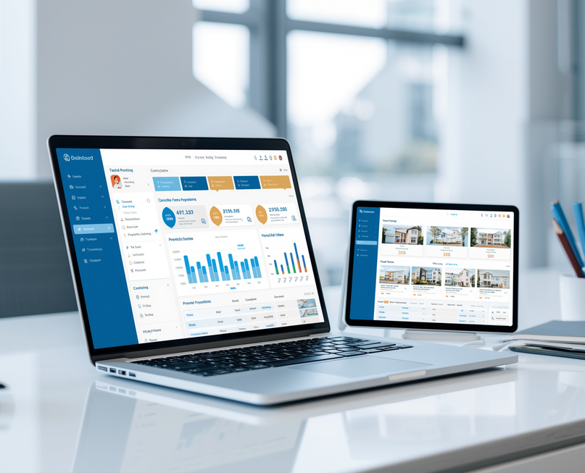
INTRODUCTION
The Real Estate Management System (REMS) is a comprehensive web-based platform designed to bridge the gap between property seekers, agents, and administrators.
This software aims to simplify the complexities of the real estate market by providing a centralized hub for managing property listings, agent profiles, and client inquiries.

Slide 3

Problem Statement
Comparing traditional real estate management approaches with our innovative REMS solution to highlight key improvements and benefits.
  Manual property and customer record management is time-consuming and error-prone.
  Difficulty in tracking property availability, sales, and rental information.
  Lack of a centralized database for efficient data management.
  Limited reporting and real-time business monitoring capabilities.
  Need for a secure, automated, and web-based Real Estate Management System to improve efficiency and decision-making.

Slide 4

Objective
The Real Estate Management System (REMS) is designed to transform traditional property management through digital innovation. Our objectives focus on creating a comprehensive, efficient, and user-centric platform.
Digitize and automate real estate operations
Reduce manual errors and workload
Improve user experience for all
Enable seamless transactions
Centralize property management

Slide 5
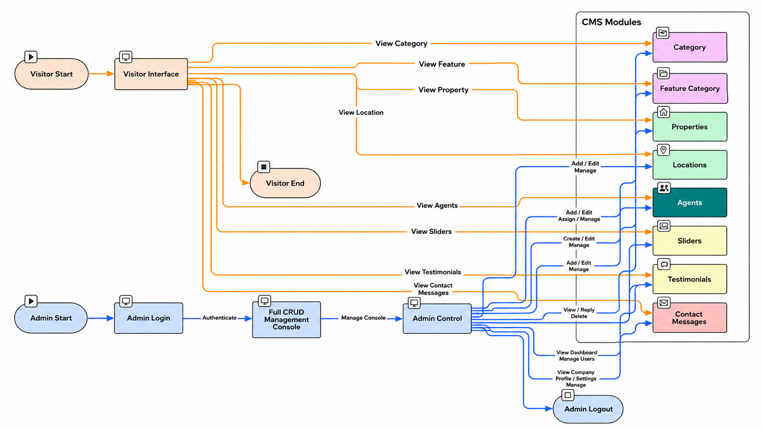
Data Flow Diagram
The Data Flow Diagram illustrates how information moves through the Real Estate Management System. It maps the journey of data between users, agents, and the central database, showing key processes and their interconnections.

Slide 6
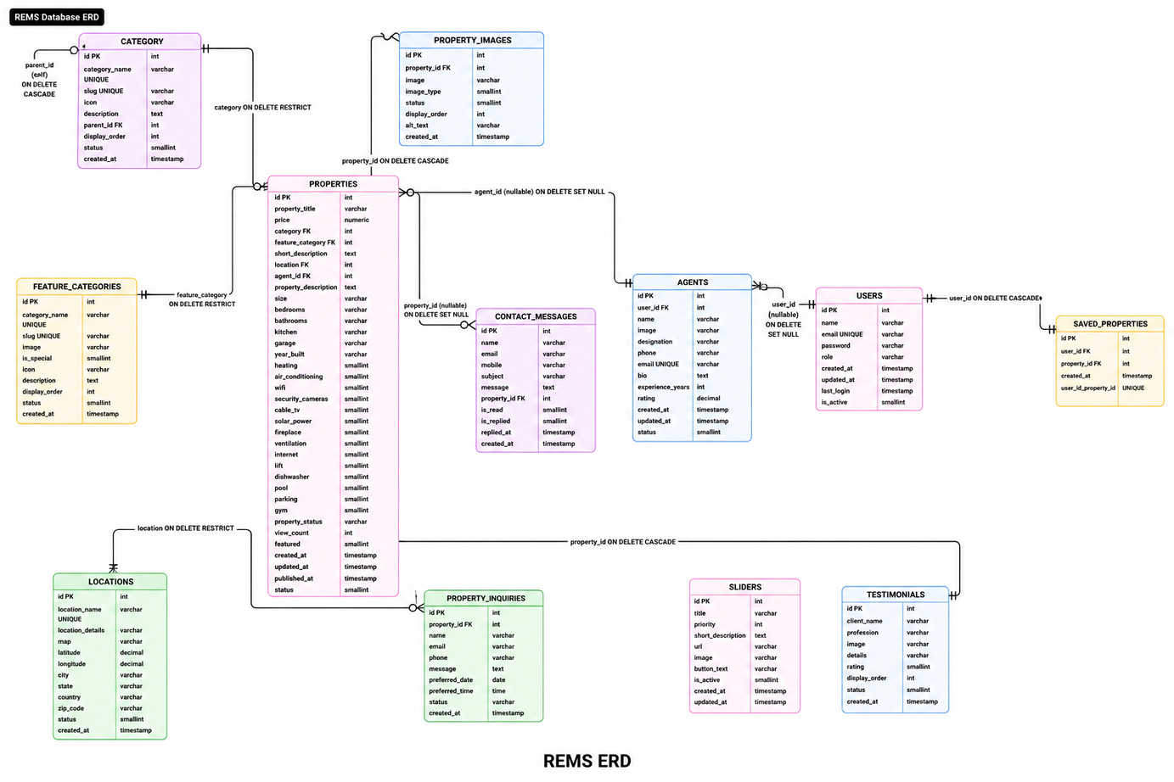

ER Diagram
The Entity-Relationship diagram illustrates the database structure of REMS, showing how different entities connect and interact within the system to manage real estate operations effectively.
Core Entities
Property, Owner, Agent, Customer - These primary entities form the foundation of the REMS database, each with unique attributes and identifiers.
Relationships
Cardinalities define how entities relate: one owner can have many properties, agents manage multiple transactions, customers can make multiple payments.

Slide 7





Tools & Technologies
The Real Estate Management System is built using modern, industry-standard tools and technologies to ensure reliability, scalability, and maintainability throughout the development lifecycle.
javaScript
PostgreSQL
Node js
Html, css

Slide 8

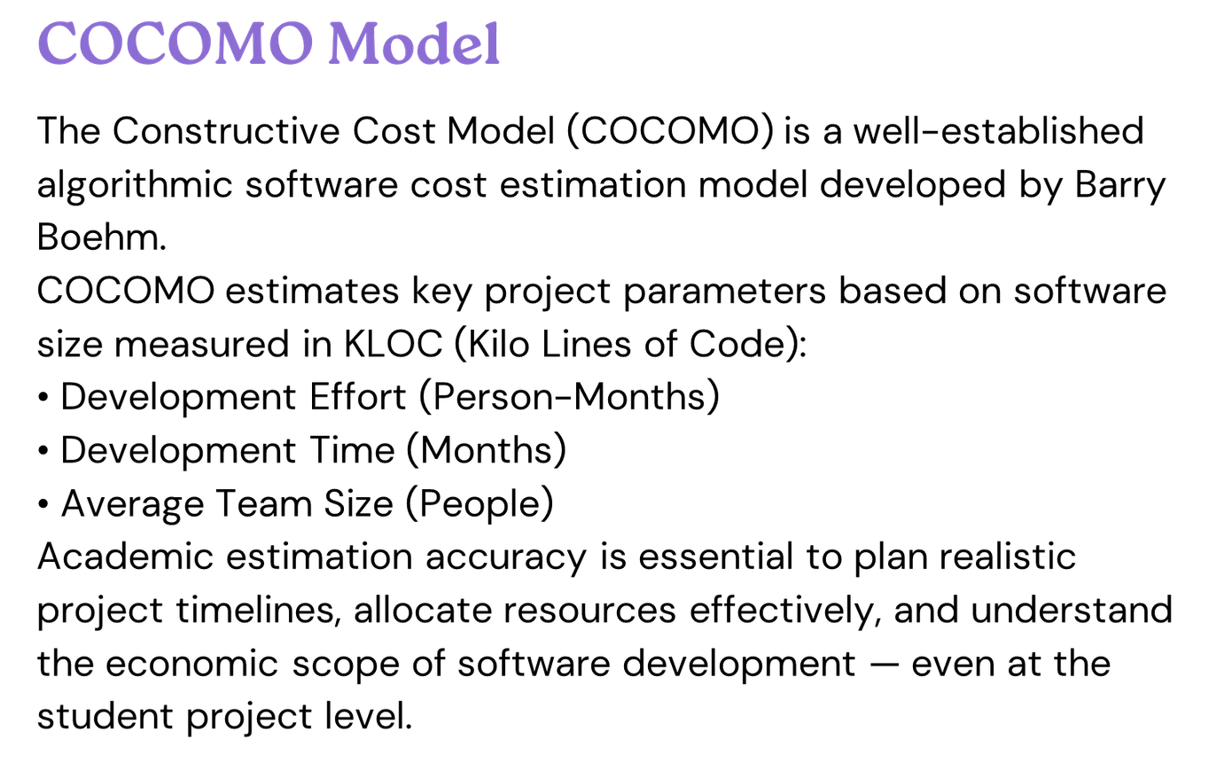
Software Cost Estimation

Slide 9
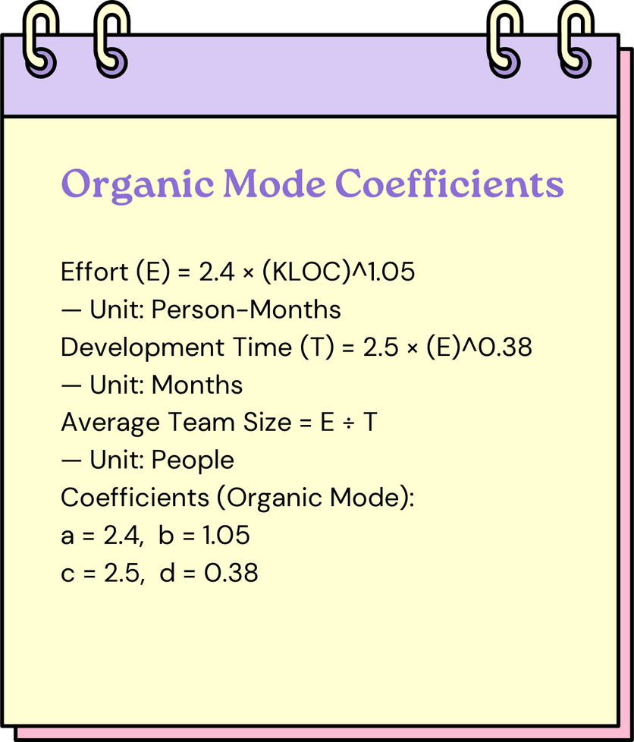
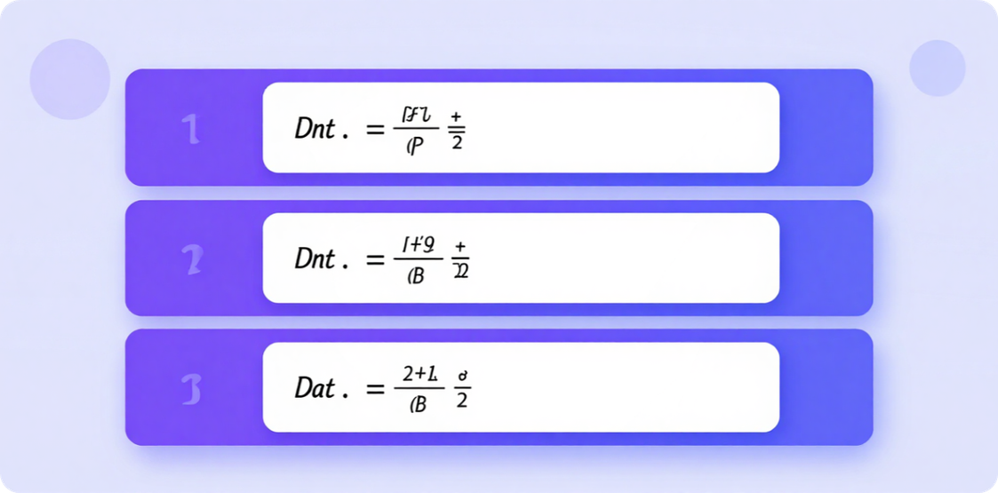
COCOMO Basic Model & Formulas

Slide 10
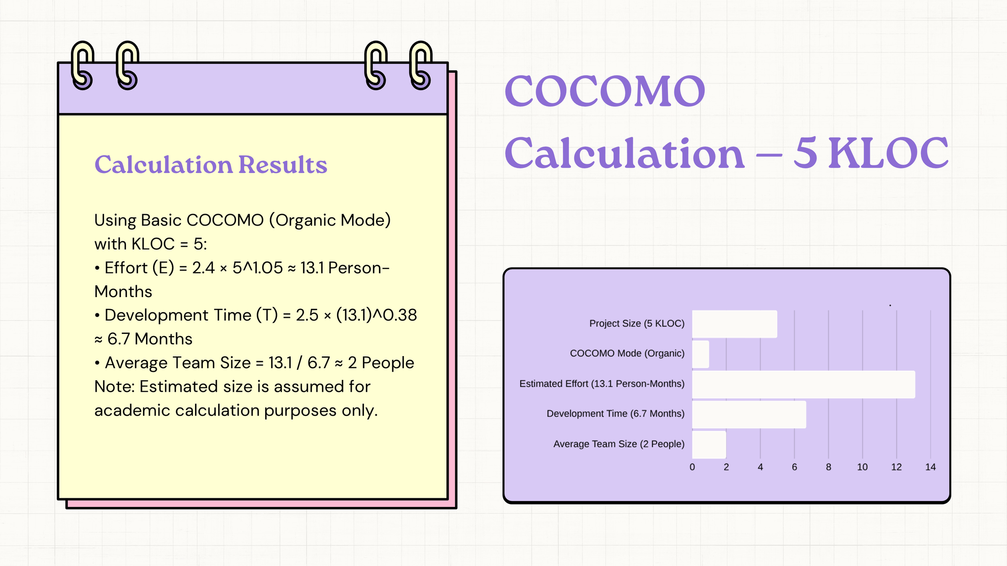

Slide 11
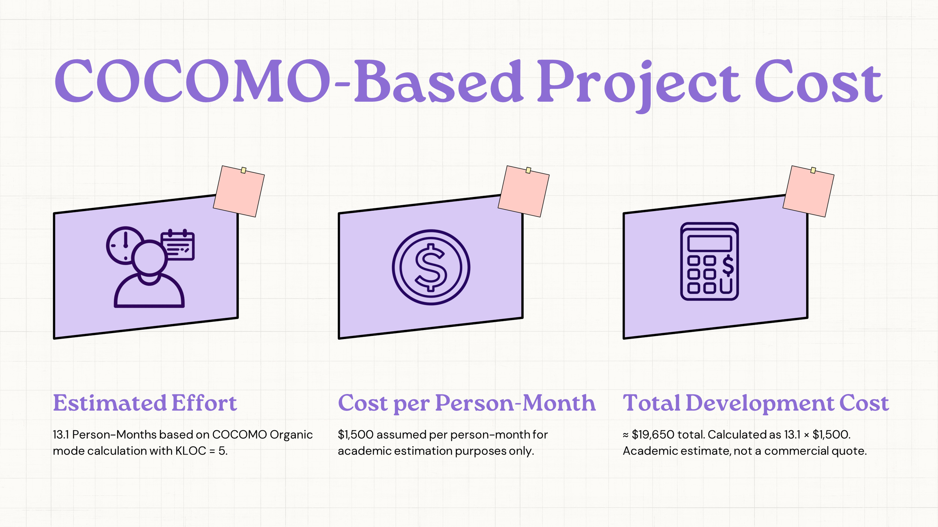

Slide 12

Risk Analysis
Identifying potential risks and implementing mitigation strategies is crucial for REMS project success. Proactive risk management ensures system reliability, security, and user satisfaction throughout the platform lifecycle.
Data Security & Privacy Concerns
System Downtime & Technical Failures
User Adoption Challenges
Market Competition

Slide 13





Limitations
While REMS offers significant improvements to real estate management, it is important to acknowledge current system constraints that may affect implementation and usage in certain scenarios.
Limited legacy system integration
Scalability with large data volumes
Dependence on internet connectivity
Initial user training required

Slide 14
CONCLUSIONS
REMS provides efficient property management with centralized PostgreSQL reliability.
System meets objectives of data consistency, admin control, and improved user experience; future work focuses on AI, mobile, and enhanced automation.

Slide 15

REMS
THANK YOU
FOR YOUR ATTENTION
QUESTIONS & DISCUSSION

